Slide 1


Slide 2

NETWORK VAPT

Slide 3
NETWORK
A computer network is a group of computer devices linked to each other that enables the computer to communicate with another computer and share their resources, data, and applications.
Each of the devices on the network can be thought of as a node; each
node has a unique address.
Computer networking refers to the method in which various computing devices can exchange data and share resources with each other.

Slide 4
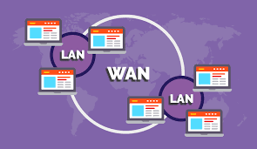
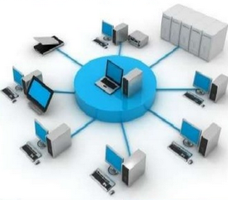
Types of Computer Network
Local Area Network
LAN is a very small area (a college building, or house) where a number of computers are connected to each other via centralized device called Switch or Hub which is connected to the Internet.
You can communicate with each other in LAN using a Switch or Hub.

Slide 5

Wide Area Network
WAN is which spans to multiple networks and consists of multiple local networks.
Usually, WAN is a connection of multiple Metropolitan Area Network(MAN), or in simple terms, internet is an example of WAN.

Slide 6
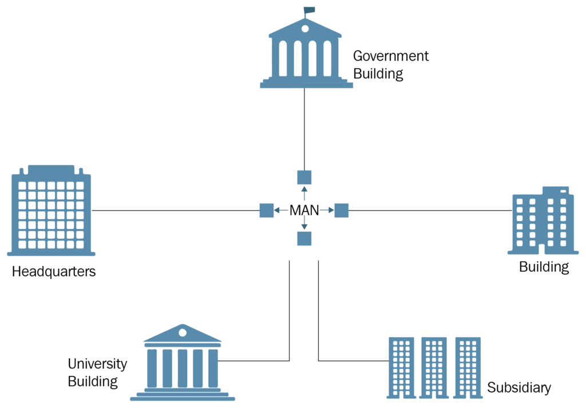
Metropolitan Area Network:
A (MAN) is a network that interconnects users with computer resources in a geographic area or region larger than that covered by even a large local area network (LAN) but smaller than the area covered by a wide area network (WAN).

Slide 7
Personal Area Network:
A personal area network ( PAN ) is a computer network organized around an individual person.

Slide 8
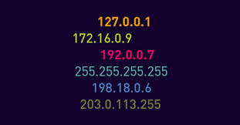
IP Address
An IP address is a unique address that identifies a device on the internet or a local network.
IP stands for "Internet Protocol", which is the set of rules governing the format of data sent via the internet or local network.

Slide 9
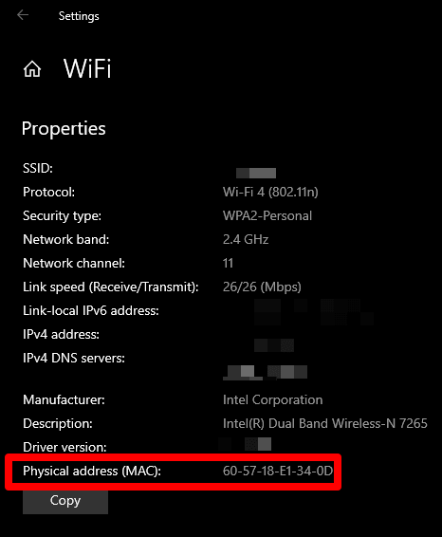
MAC Address
The physical address - “Media Access Control” address.
It identifies a device to other devices on the same local network

Slide 10
Public & Private IP address:
Private IP Address | Public IP Address
used for communicating within a private network. Cannot be directly contacted over the internet. | used to communicate over the public internet outside a private network.
Addresses can be reused per network. | Addresses are unique & cannot be reuse.
Assigned to a device by a router. | Assigned by a ISP.
Has a small set of range of possible addresses. | Addresses can be any combination of numbers not within the private IP range.

Slide 11






140.16.36.96
192.168.1.2
Server
192.168.1.1
192.168.1.3
192.168.1.4

Slide 12
NETWORK SECURITY
=> Any activity that is specially designed in order to protect the usage and integrity of users network and data.
Includes both software and hardware technologies
It focuses on targeting variety of threats
Prevents any malware from entering and infecting users network
=> Network security works by combining multiple defense layers within the network.
=> Each network security layer implements policies and controls. Authorized users gain access to network resources, but malicious actions are blocked from carrying out exploits and threats.

Slide 13
NETWORK SECURITY DEVICES
Firewall
Intrusion Detection System
Intrusion Prevention System
Antivirus
Data Loss Prevention (DLP)
Security Information and Event Management (SIEM)

Slide 14
NETWORK VAPT
Network VAPT is a type of security testing that can be done either manually or by using tools to ensure that the network is not exhibiting any means of evasion.
Vulnerability Assessment involves finding security holes i.e. vulnerabilities by scanning the entire network.
Penetration Testing involves exploiting the found vulnerabilities to gain unauthorized access to the network.

Slide 15

WHY SHOULD NETWORK VAPT
BE PERFORMED?
External attacks have become easily possible due to availability of hacking tools
All firms and corporates who process or store their data as well as data belonging to their customers
It is imperative to scan the networks periodically and fix the loopholes
Firewall mis-configurations being one major cause of data leakage and hackings
Server patching contributes into network security vulnerabilities to a great extent
Any critical change in the network devices ideally calls for a VAPT of those components

Slide 16
Process
1
2
RECONNAISSANCE
SCANNING
4
3
VULNERABILITY
ASSESSMENT
EXPLOITATION
5
REPORT

Slide 17
network vapt process
Process is similar to Ethical Hacking ;
- Connect to an IP address
- Scan Ports (TCP/UDP)
- Map Services
- Find / Exploit vulnerability
- Report vulnerability
=> Tools scan for - Services, open ports, software version, Firmware
If anything is outdated from above scanning find the exploit or CVE for that

Slide 18
Tools
Automated scanners - Nessus
Nmap
nmapAutomator - https://github.com/21y4d/nmapAutomator
Nmap scripts
Metasploit
Dirb
Nikto
Netcat
Google to search CVE and Exploits

Slide 19
REFERENCES
https://www.valencynetworks.com/penetration-testing-services/network-testing.html
https://aws.amazon.com/what-is/computer-networking/
https://www.javatpoint.com/types-of-computer-network
https://cybersrcc.com/network-security-va-pt/
https://www.guru99.com/vulnerability-assessment-testing-analysis.html
https://www.opensourceforu.com/2017/06/basics-vulnerability-assessment-penetration-testing/
https://www.researchgate.net/figure/Network-VAPT-Process-2_fig1_336439468
https://www.researchgate.net/figure/Network-VAPT-Process-2_fig1_336439468
https://www.google.com/search?client=firefox-b-d&q=network+architecture

Slide 20
THANK
YOU!

